Slide 1

Multi-Unicast Capacity of Packet-Level Network Coding on Small Wireless Networks
Chih-Chun Wang Purdue University
8/21/2013
Sponsored by NSF CCF-0845968 and CNS-0905331.

Slide 2
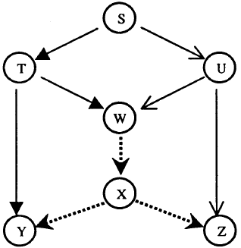
A New Paradigm
Network Coding (NC) is optimal when there is only 1 flow in the network.
Linear NC (LNC) [Li et al. 03]
Random LNC [Ho et al. 06]
1-flow erasure network capacity [Dana, Hassibi 06]
Many important applications
Secure network coding [Cai, Yeung 02]
One time pad
Network error correction [Cai, Yeung 06]
Distributed Storage Networks [Dimakis et al. 10]
Rateless broadcast [Luby 02]
Content distribution networks, P2P, and many more.
Fig. 1(b) in [Li et al. 03]

Slide 3









When there are multiple flows …
Whether can we send (R1,R2,…,RM) symbols for flows 1 to M, respectively?
Many important applications
Cellular / access-point networks [Rozner et al. 07]
Mesh networks [Katti et al. 06]
Index coding [Bar-Yossev et al. 06] (satellite comm.)
A notoriously difficult problem
NP complete.
Linear codes are suboptimal.
Whether rates (R1,R2,…,RM) are linearly feasible can depend on the alphabet size [Dougherty et al. 05, 07, 08].
Even finding good (but loose) capacity bounds is hard [Kamath et al. 13].

Slide 4


2 Probable Causes of Hardness
Checking “whether (R1,R2,…,RM) are feasible for general networks” is NP hard.
Two probable causes of hardness
Cause 1: Number of coexisting flows.
1 flow: Easy! R1*=min-cut(s,t).
2 flows: Checking whether (1,1) is feasible is in P. [W., Shroff 07].
6 flows: Non-Shannon inequalities are needed for (1,1,1,1,1,1).
10 flows: Sometimes we need nonlinear codes for (1,1,…,1).
However, new results [Kamath, W. 13]: The (R1,R2,…,RM) problem is no harder than the 2-flow (a,b) problem, where
Cause 2: Network topology.
Question: What is the multi-unicast capacity region for practical (small) network scenarios? Wireless?

Slide 5
Content
The setting:
Small wireless networks
Interconnected by broadcast packet erasure channels
Delayed reception status feedback. I.e., we allow the use of ACK.
Several small network topologies of interest
Motivations / applications,
Some new observations,
New capacity results.
A new design and analysis framework for achieving the linear NC capacity.
How to analyze the LNC capacity of the aforementioned network topologies in a systematic way?
Conclusion

Slide 6




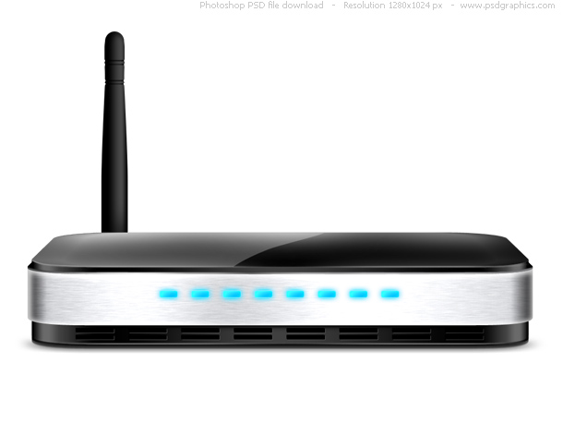

Broadcast Packet Erasure CH.
2-receiver broadcast packet erasure channel
Each input W is a packet in .
A random subset of users {d1,d2} receives it.
Stationary and memoryless (i.i.d. over time).
Described by .
Multiple unicast flows.
Applications of PECs:
An access-point network with 2 clients.
Uncontrollable interference / unknown fading.
Causal Channel State Info (CSI) feedback:
After each transmission, dk reports the CSI back to s through ACK/NACK.
PEC

Slide 7



Broadcast Packet Erasure CH.
2-receiver broadcast packet erasure channel
Each input W is a packet in .
A random subset of users {d1,d2} receives it.
Stationary and memoryless (i.i.d. over time).
Capacity results:
Without feedback: Degraded channel arguments time-sharing is optimal.
With feedback: The capacity is found in [Georgiadis et al. 09]
The “Classic XOR” coding operation.
Send [X+Y] that combines overheard X and Y.
PEC
R1
Achieved by
Classic-XOR.
R2

Slide 8
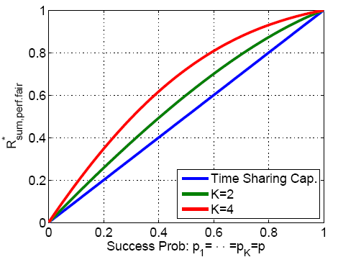
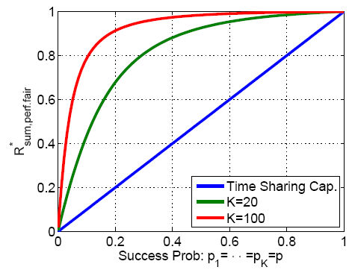
Broadcast PECs with (delayed) ACK.
Variant 1: Split the destinations
Applications: Wi-Fi in a conference environment.
New concept: Code Alignment + Classic XOR [W. 10]
Results: Capacity region for various parameter values [W. 10]
PEC
Well understood!
PEC

Slide 9
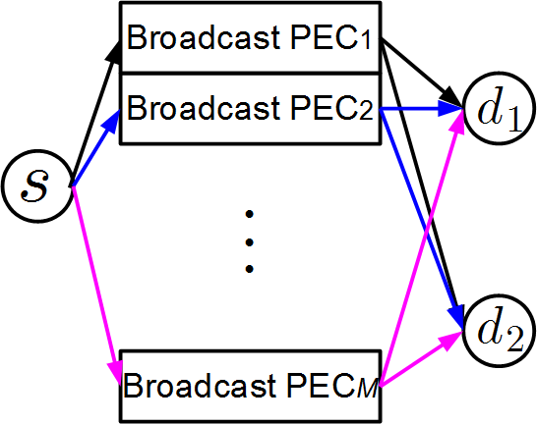
Broadcast PECs with (delayed) ACK.
Variant 2: Split the channel [W., Love, 12]
Send M symbols simultaneously in each time slot.
Each symbol experiences independent erasure events.
Applications: OFDMA, MIMO, Time-varying channels.
PEC
Variant #1:
PEC
Multi-input Broadcast PEC

Slide 10
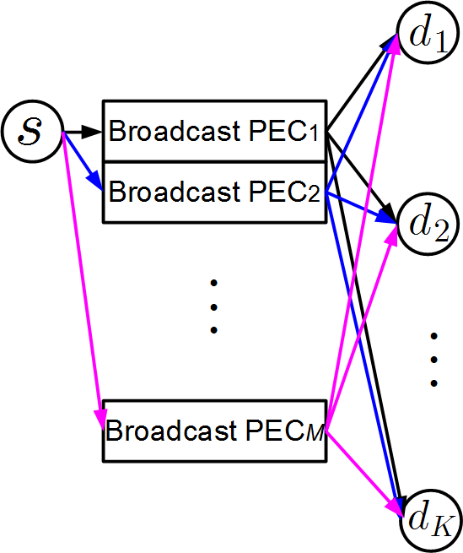
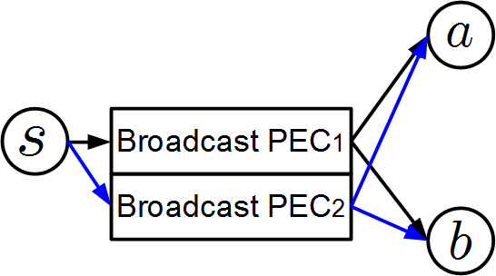
Applications of Multi-Input Broadcast PECs
M-input K-receiver broadcast PECs
Application 1: OFDMA?
Application 2: Cognitive radio. Assuming 50% in a good state and 50% in a bad state, then serial-to-parallel conversion gives us
Application 3: Channel with memory
With CSI feedback, it is equivalent to the case of cognitive radio.
state
PEC

Slide 11
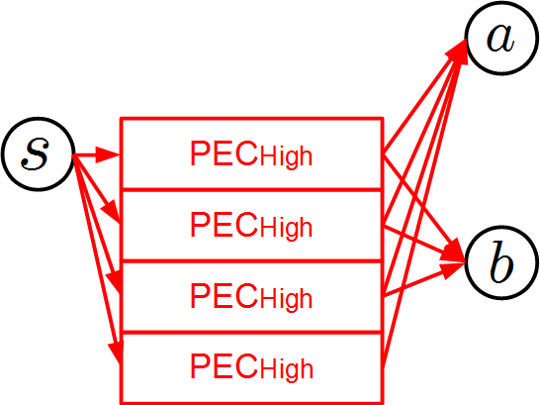
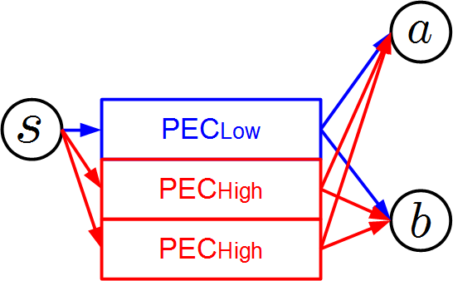
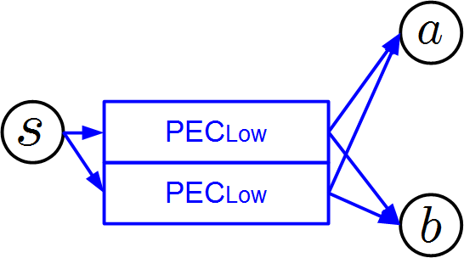
Applications of Multi-Input Broadcast PECs
M-input K-receiver broadcast PECs
Application 4: Rate adaptation
High-order modulation (e.g. 256QAM) with high-rate coding vs. Low-order modulation (e.g. QPSK) with low-rate coding vs. Mixture?
Pure throughput vs. diversity.
Comparison between 3 static scheduling policies:
A first step towards dynamic/opportunistic scheduling.
100% High
50% High 50% Low
100% Low

Slide 12
Broadcast PECs with (delayed) ACK.
Variant 2: Split the channel [W., Love, 12]
Send M symbols simultaneously in each time slot.
Each symbol experiences independent erasure events.
Applications: OFDMA, MIMO, Time-varying channels.
New observation: Classic XOR is not sufficient.
PEC
Variant #1:
PEC
Multi-input Broadcast PEC

Slide 13
Classic XOR is not enough
Classic XOR
Xi is overheard by d2; Yj is overheard by d1; Send [Xi+Yj].
Optimal for stationary channels [Georgiadis et al. 09].
Strictly suboptimal for time-varying channels.
Example 1: A specific time-varying PEC.
Each time slot, the success prob. can be described by
Goal: Transmit as many packets as possible in 2 time slots.
Time slot 1: (0, ½, ½, 0)
Exactly one of d1 and d2 will receive it. But which node is uncertain.
Time slot 2: (0,0,0,1)
Both d1 and d2 will receive it.
Channel states for both time slots are known beforehand.
state
PEC

Slide 14
Example 1
state
Classic XOR is very important for the multi-uncast setting, but is not the only way to extract NC throughput gain.
PEC
Classic XOR: X is overheard by d2; Y is overheard by d1; Send [X+Y].
Avg. throughput:
Even when focusing on infinitely many time slots, 1.75 pkts / 2 slots 2 pkts / 2 slots
 | Classic XOR | New Optimal Solution
t=1
No overheard packets Send X.
Send [X+Y] even though neither has been overheard before.
(0, ½, ½, 0)
d1 got it.
d2 got it.
d1 got it.
d2 got it.
Send Y
Send X
Send Y
Send X
t=2
(0,0,0,1)
d1 gets X (and Y); d2 gets Y.
d1 gets X; d2 gets (X).
d1 gets [X+Y], Y and decodes X;
d2 gets Y.
d1 gets X;
d2 gets [X+Y], X and decodes Y.
2
1
2
2
1.5 pkts / 2 slots
<
2 pkts / 2 slots
<

Slide 15
Broadcast PECs with (delayed) ACK.
Variant 2: Split the channel [W., Love, 12]
Send M symbols simultaneously in each time slot.
Each symbol experiences independent erasure events.
Applications: OFDMA, MIMO, Time-varying channels.
New observation: Classic XOR is not sufficient.
Results: Linear NC capacity region [W., Love, 12]
PEC
Variant #1:
PEC
Multi-input Broadcast PEC

Slide 16
Broadcast PECs with (delayed ACK)
Variant 1: Split the destinations.
Variant 2: Split the channel.
Variant 3: Split the source!
PEC
Variant #1:
PEC
Variant #2:

Slide 17




Split the source
Termed the proximity network.
Every time instant, only one of s1 and s2 can transmit.
1-bit feedback
p
a
p
p
s2
s1
Erasure Ch.
sym. success prob. q
Erasure Ch.
p
p
b
p
1-bit feedback
In practice, s1 and s2 may sometimes overhear each other.
One cannot send [Xi+Yj] anymore!
Since Xi and Yj are situated in different physical nodes.
When q=0, time sharing is optimal. No NC can be done.
When q=1, the same as 1-to-2 PEC [Georgiadis et al 09].

Slide 18
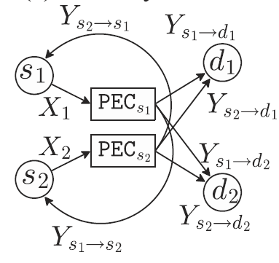
Full-coordination.
PEC
Capacity results
sum rate
No-coordination. Time-sharing is optimal!
q: The source-to-source overhearing prob.
0
q=p/(3-p)
1
Challenges to be addressed: (1) Coordination through unreliable overhearing.
(2) Cyclic dependence (s2 in the past -> s1 in the present -> s2 in the future).

Slide 19
Broadcast PECs with (delayed ACK)
Variant 1: Split the destinations.
Variant 2: Split the channel.
Variant 3: Split the source!
New concept: Interactive coordination through overhearing.
Results: Capacity region for arbitrary p and q. [W. 12]
PEC
Variant #1:
PEC
Variant #2:

Slide 20
Why Studying The Proximity Network?
Critical to our understanding of general wireless networks.
XOR in the air:
Inter-flow coding
A common relay r.
A more likely scenario:
The distinct r1 and r2 are physically close to each other.
The results suggest that “We can/may still capitalize full coordination benefits even with weak overhearing q=p/(3-p).’’
The proximity network.

Slide 21
Broadcast PECs with (delayed ACK)
Variant 4: Receiver coordination
TDMA: For each time slot, at most one node can transmit!
PEC
Variant #1:
Variant #3:
PEC
Variant #2:

Slide 22

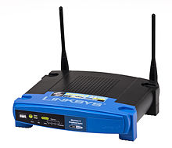


Application of Variant 4
Home Wi-Fi environment
1 router and 2 clients.
Client cooperation.
Half Duplex antenna
Carrier Sense Multiple Access (CSMA)
TDMA: Only one node can transmit in any given time slot.
Question: What is the optimal way of exploiting the ability of client-to-client Wi-Fi comm.

Slide 23

Broadcast PECs with (delayed ACK)
Variant 4: Receiver coordination
New concept: Joint scheduling and NC design.
Scheduling can depend on the reception status.
Results: Linear NC capacity region for arbitrary parameters. [W. 13]
PEC
Variant #1:
Variant #3:
PEC
Variant #2:

Slide 24
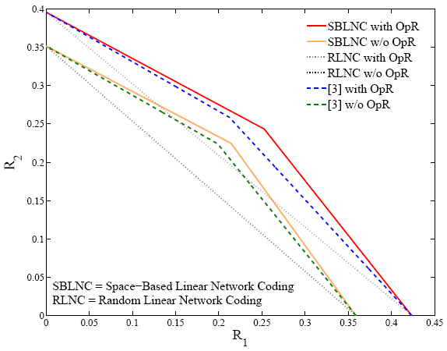
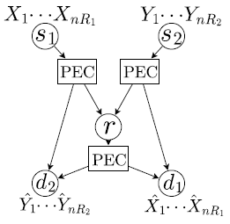
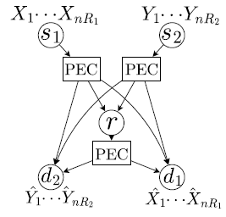
Broadcast PECs with (delayed ACK)
Variant 5: Wireless Butterfly
Results: Capacity region and tight bounds [Kuo, W. 11]
PEC
Variant #1:
Variant #3:
PEC
Variant #2:
Variant #4:

Slide 25
Good news:
Many practical wireless networks are small (2 to 3 hops) and can be closely modeled as PEC networks.
The corresponding multi-unicast capacity (or linear NC capacity) can be characterized and achieved.
Optimal protocol is possible. [Koutsonikolas, W., et al. 12]
The NP hardness results are indeed the worst-case scenario.
Bad news:
Outer bound:
We need new outer bounds that consider scheduling, (delayed) feedback, and cyclic dependence.
Achievability:
Many different coding operations need to be invented.
Question: Can we develop a unified solution that simultaneously find the inner and the outer bounds?

Slide 26
Question: Can we develop a unified solution that simultaneously find the inner and the outer bounds?
The proposed solution: A coding-type-based framework for analyzing and achieving the linear NC capacity with (delayed) ACK feedback.

Slide 27
Demonstrate The New Framework
Re-derive the capacity of
We use the 1-to-1 channel as a further simplified example to demonstrate the concept.
Use the new framework to derive the LNC capacity of
PEC

Slide 28


A Critical Definition: The Knowledge Spaces
PEC
Joint message space:
Individual message subspaces:
Intersession coding vector (denoted as v or c):
Knowledge spaces: The span of vectors di has received.
Decodability:
Definition of the sum space:

Slide 29






A Systematic Way to Dissect The NC Choices
Consider a single hop
The message space .
The knowledge space at d.
We have at least two different coding types
Type 0: Convey/send a coding vector .
Effect: When d receives a Type-0 packet, increases.
Type 1: Convey/send a coding vector .
Effect: When d receives a Type-1 packet, remains.
Question: Do we have a third coding type? (Can we have a vector that is neither Type-0 nor Type-1?)
Ans: No. A vector is either in or not in .
The above classification of coding types is exhaustive.
Type-0 vector
Type-1 vector

Slide 30



Dissecting the NC choices – A systematic approach
Type 0: Convey/send a coding vector .
Effect: When d receives a Type-0 packet, increases.
Type 1: Convey/send a coding vector .
Effect: When d receives a Type-1 packet, remains.
: normalized # of Type-0 vectors, : normalized # of Type-1 vectors.
Time-sharing inequality: .
Rank conversion: Define y1 be the normalized .
Rank comparison: .
Decodability:
Feedback is used to trace the evolution of the knowledge spaces. We do not need any degraded channel arguments.
It is an outer bound since any coding choices can be classified as one of the two types (the coding types are exhaustive).
It also guides the construction of capacity-achieving scheme:
Optimal ⬄ Send as many Type-0 vectors as possible.
ARQ is optimal; RLNC is optimal.

Slide 31
A Quick Summary
Use the knowledge spaces to exhaustively enumerate all coding types.
Use the xi variables to denote the frequency of sending type-i.
Time-sharing inequality
Use the yj variables to denote the ranks of the knowledge spaces.
Rank conversion from xi to yj.
Rank comparison: yj versus rank(Ω).
Decodability condition.
Type-0 vectors
Type-1 vectors

Slide 32

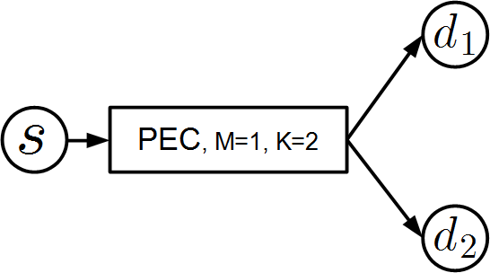







The 2-Rec. Broadcast PEC
How to make sure we enumerate exhaustively the coding types, so that any belongs to one and only one of them?
Ans: We focus on the "knowledge spaces of interest" and use the inclusion and exclusion principle.
Example: 2 knowledge spaces of interest: and
Type-00: , Type-01: , Type-10: , Type-11: .
normalized # of Type-b1b2 vectors.
Time-sharing:
Rank-conversion: yi is the normalized rank of Si. and .
Rank Comparison: .
Decodability:

Slide 33



The 2-Rec. Broadcast PEC
Type-00: , Type-01: , Type-10: , Type-11: .
Time-sharing:
Rank-conversion: yi is the normalized rank of Si. and .
Rank Comparison: .
Decodability:
Lead to a valid outer bound:
A simple cut-set bound. Obviously not achievable.
Why?
Reason 1: With the overall space , the rank-based decodability inequality becomes necessary but not sufficient.
Example:
Solution: We observe
.
We thus need to trace two more ranks: y3 be the normalized
y4 be the normalized

Slide 34







The 2-Rec. Broadcast PEC
Type-00: , Type-01: , Type-10: , Type-11: .
Why the outer bound cannot be achieved?
Reason 1: The rank-based decodability inequality is necessary but not sufficient.
Reason 2: Not all valid x00, x01, x10, x11 assignments can be converted to an achievability scheme.
Example: If p10+p11=p01+p11=0.5 & R1=R2=0.25, then a valid assignment is x01=x10=0.5, x00=x11=0, y1=y2=0.25.
An achievability scheme would send Type-01: for 50% of the time and send Type-10: for 50% of the time.
Initially, both S1 and S2 are empty. → → It is impossible to send either Type-01 or Type-10.
p11
(2) Not all x0 x1 x2 x3 assignment can be converted to an achievability scheme.
Solution: We observe that whether we can send a Type-10 packet depends on whether . By the equality , we thus need to trace one more rank: y5 be the normalized .
Sol: Trace and
Sol: Trace
0.5
0.5
0.25
0.5
0.5
The more spaces we are tracing, the tighter the outer bound.
0.25
0.5
0.5

Slide 35
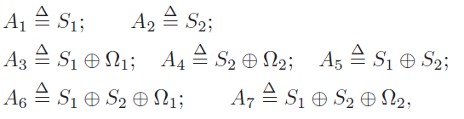


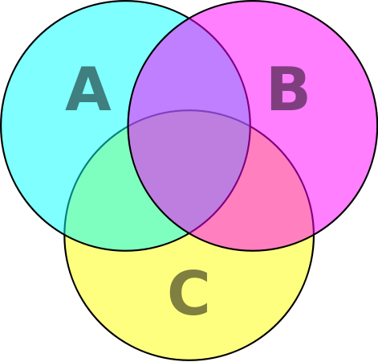

Deriving The Capacity
We trace the rank of 7 linear spaces:
Five from the previous discussion; and trace the joint relationship between S1, S2, Ω1 and Ω2.
A1 to A7 thus leads to 2⁷=128 coding types.
We have captured all possible coding types.

Slide 36
Revisit Example 1
Classic XOR: X is overheard by d2; Y is overheard by d1; Send [X+Y].
Y
X
Y
X
X
Y
Y
X
Y
X
X
Y
X
Y
 | Classic XOR | New Optimal Solution
t=1 | No overheard packets Send X. | Send [X+Y]
Type-0000000 (0)
(0, ½, ½, 0)
Type-0010010 (18)
d1 got it.
d2 got it.
d1 got it.
d2 got it.
Type-0011011 (27)
t=2 | Send Y. | Send X | Send Y | Send X
 | d1 gets X (and Y); d2 gets Y. | d1 gets X; d2 gets (X); | d1 gets [X+Y], Y and decodes X; d2 gets Y. | d1 gets X; d2 gets [X+Y], X and decodes Y.
(0,0,0,1)
Type-0011111 (31)

Slide 37
The key message is not that
we can express the existing Classic-XOR as coding type 31;
and the optimal solution contains coding types 0 and 27.
The key message is that we have captured all possible coding types.
Other than types 18, 31, 0, and 27 in the previous slide, there are 128-4=124 other coding types that have not been carefully discussed in the previous example (and any existing literature).
In fact, the way we found the optimal solution is by ``systematically” examining the benefits of all 128 coding types.
Will be elaborated later.

Slide 38
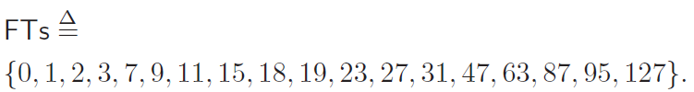
Deriving The Capacity (Cont’d)
We trace the rank of 7 linear spaces:
Five from the previous discussion; and trace the joint relationship between S1, S2, Ω1 and Ω2.
A1 to A7 thus leads to 2⁷=128 coding types.
Some coding types can be discarded without loss of optimality/generality.
Only 18 types (out of 128) need to be considered. These are termed the feasible types (FTs)
Index set

Slide 39


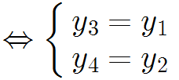
Deriving The Capacity (Cont’d)
We trace the rank of 7 linear spaces:
Only 18 types (out of 128) need to be considered. The are termed the feasible types (FTs)
Time-sharing inequality: .
Rank-conversion: 7 equalities - from xb to y1 … y7. For example,
Rank Comparison: For example, we have y3 ≤ y6 since .
Totally there are 8 basis rank comparison inequalities.
Decodability:
It is now provable that any valid assignment can be converted to an achievability scheme.
=> The outer bound is thus indeed the capacity!

Slide 40
The Final Result (Cont’d)
For any given channel parameters, we can use an LP solver to solve the capacity-LP problem.
In many multi-input PEC instances, we see that
Type-0 and type-27 are non-zero.
That is actually how we found the optimal solution in Example 1.
 | Classic XOR | New Optimal Solution
t=1 | No overheard pkts Send X. | Send [X+Y]
Type-0000000 (0)
(0, ½, ½, 0)
Type-0010010 (18)
d1 got it.
d2 got it.
d1 got it.
d2 got it.
Type-0011011 (27)
t=2 | Send Y. | Send X | Send Y | Send X
 | d1 gets X (and Y); d2 gets Y. | d1 gets X; d2 gets (X); | d1 gets [X+Y], Y and decodes X; d2 gets Y. | d1 gets X; d2 gets [X+Y], X and decodes Y.
(0,0,0,1)

Slide 41
Summary of The New Framework
Introduce the coding types.
Use ACK to trace the evolution of the knowledge spaces.
The relative frequency variable xi.
Combine with the classic Shannon- type inequalities
The rank variables yj and the rank comparison inequalities
Systematically find the new optimal coding types
By noticing non-zero x0 and x27.
Count only the relative frequency xi, not on the sequence/order of which coding type is scheduled first.
Circumvent the difficulty of cyclic dependence.

Slide 42
Conclusion
Multi-unicast linear NC capacity can be derived for small practical scenarios.
Optimal multi-uncast NC implementation is possible.
5 different variants and their capacity results.
PEC
Variant #1:
Variant #2:
Variant #3:
Variant #4:
Variant #5:
PEC

Slide 43
Conclusion
Multi-unicast linear NC capacity can be derived for small practical scenarios.
Optimal multi-uncast NC implementation is possible.
5 different variants and their capacity results.
A unified design and analysis linear NC framework based on the concept of coding types and (delayed) ACK feedback.
A, B, and C are knowledge spaces.
A systematic way of finding the outer and inner bounds of the linear NC capacity.
In some small networks, we can also prove that linear NC achieves the Shannon capacity.

Slide 44
The end!

